Slide 1
IDS: Intrusion Detection System
Dr. Arshad Farhad

Slide 2
Lecture Content:
Firewall
Packet filtering
Proxy server
IDS?
Methods/Techniques
Signature based IDS
Anomaly based IDS
Types of IDS
NIDS
HIDS

Slide 3
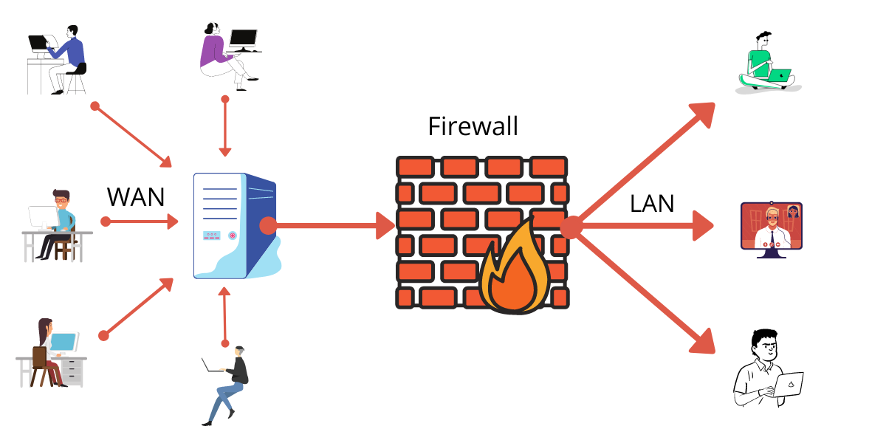
Firewall
Preventing unauthorized access to or from your internal network

Slide 4
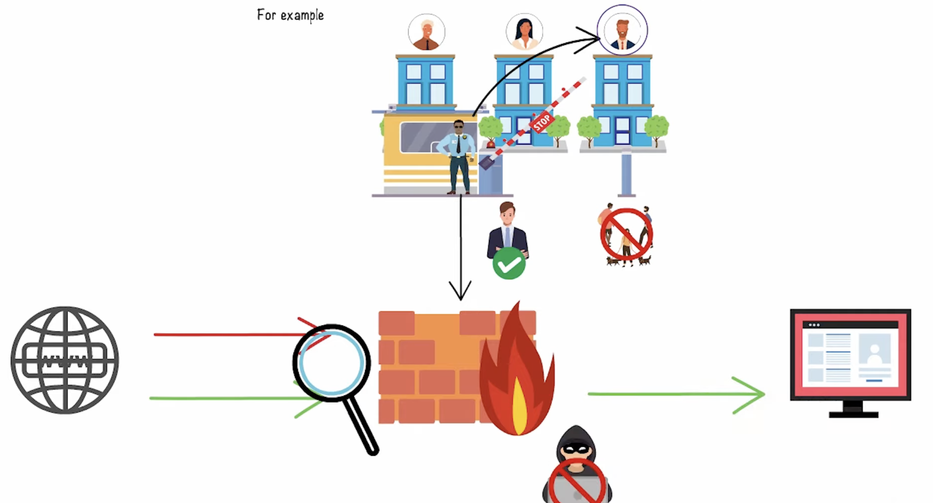
Firewall

Slide 5
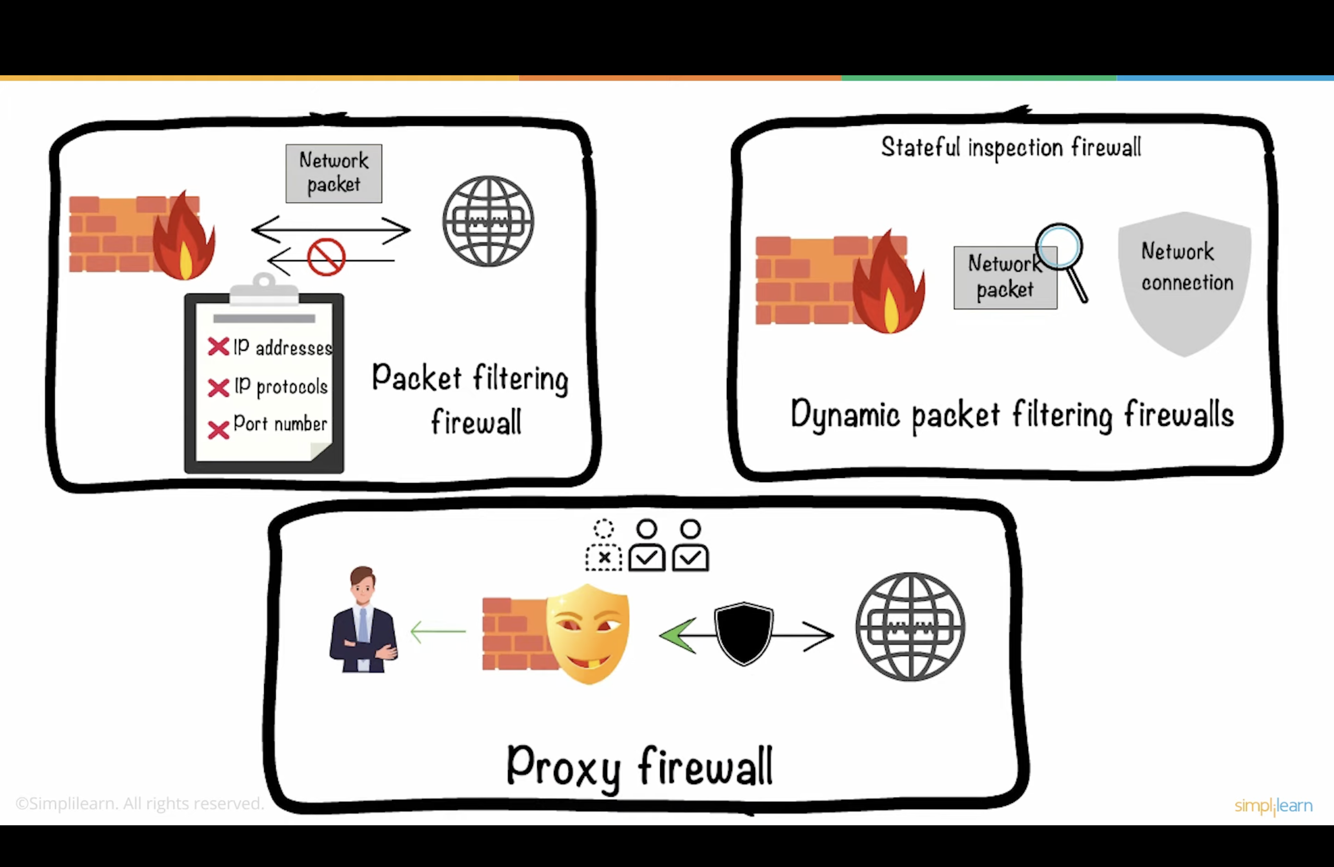
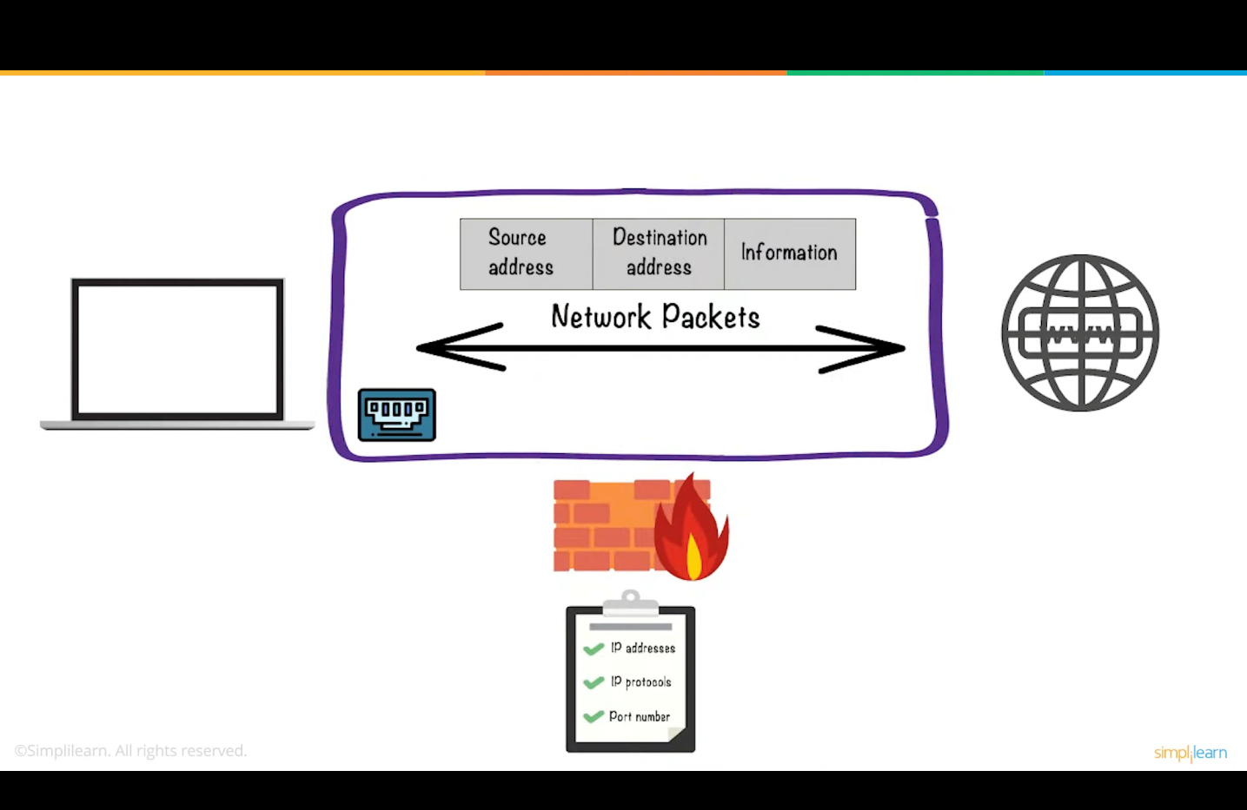
Firewall – Types: Packet Filtering
Set of rules: Src. Add, Dest. Add, port number, protocols.
If any rule matched, forward or discard the data packet.
If packet is not matched with any of the rules, by default, it discards the packet.
Firewall
LAN
Notes:
It does not check the payload/data, it is therefore not secure

Slide 6
Firewall – Types: Packet Filtering
Operates at the network layer
Rules
Set of rules: Src. Add, Dest. Add, port number, protocols.
Forward or discard
If any rule matched, forward or discard the data packet.
Default
If packet is not matched with any of the rules, by default, it discards the packet.
Firewall
LAN
Notes:
It does not check the payload/data, it is therefore not secure

Slide 7

Firewall – Types: Packet Filtering
Notes:
Blocked based on IP address

Slide 8
Firewall – Types: Application level Gateway (Proxy server)
Operates at the application layer of the OSI
More secure (checks the data/payload) – then sent to the internal host
When a user inside a private network requests access to a resource outside the network (such as a website), the request goes through the proxy firewall.
Notes:
The request is passed through proxy server, both ways.

Slide 9
IDS:
Intrusion Detection System

Slide 10
IDS: Intrusion Detection System
Intruder: Is a person, who is trying to get unauthorized access to a system or network.
Intruders may be from outside the network or legitimate users of the network.
Inside intruder (masquerader)
Has access to the system/network upto some extent (to resources)
Misuse of the legitimate previlages.
Very harmful and difficult to detect.
Outside intruder (misfeasor)
Has no access to the system/network
Tries to penetrate the network to gain access

Slide 11
IDS: Intrusion Detection System
An intrusion is a deliberate, unauthorized attempt to access or manipulate information or systems and to render them unreliable or unusable (by the intruder).
Misuse of the network/system resources.
When suspicious activity is from your internal network, it can also be classified as misuse.
Identifying the intrusion is called IDS.
Intruder
Intrusion
IDS

Slide 12
IDS: Intrusion Detection System
Continuously monitoring the system/network (data traffic).
Checks for malicious activity (privilege)
IDS looks for attack signatures, which are specific patterns that usually indicate malicious or suspicious intent.
If malicious activity is found, an alert is generated for network admin.
Intruder
Intrusion
IDS

Slide 13
Techniques of IDS

Slide 14
Intrusion Detection Systems (IDS)
Techniques
Signature based IDS
Anomaly detection based IDS

Slide 15
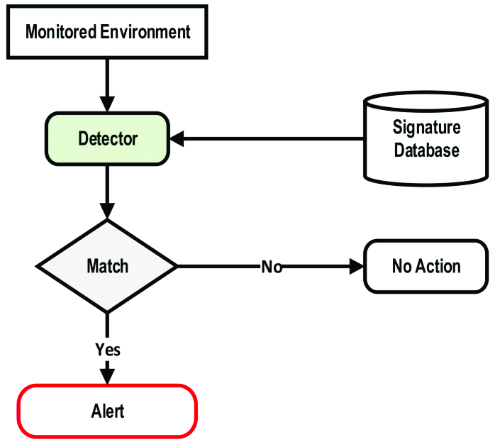
Signature based IDS
A signature is a unique pattern or identifier:
It may be a byte sequence in network traffic or inside a file or a series of instructions.
Designed to quickly identify patterns in network traffic that indicate malicious activity or unauthorized access.
Malicious activity, often called malware, is an umbrella term that describes any malicious program or code that is harmful to computer systems (e.g., trojans, viruses, worms).
Signature-based detection examines network traffic, compares it to known signatures, and generates an alert when a match is made.

Slide 16
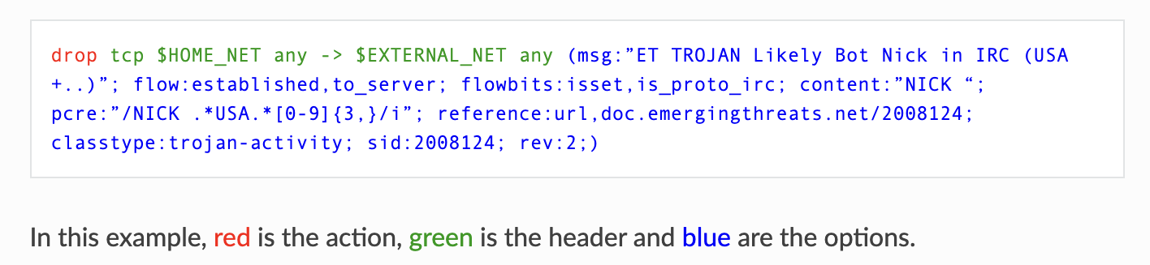
Cont’d…
One example of an IDS that implements signature-based detections is Suricata
Action - what happens when the signature matches
Header - defining the network information (e.g., protocol, IP addresses, ports, and direction)
Options - defining the specifics of the rule

Slide 17
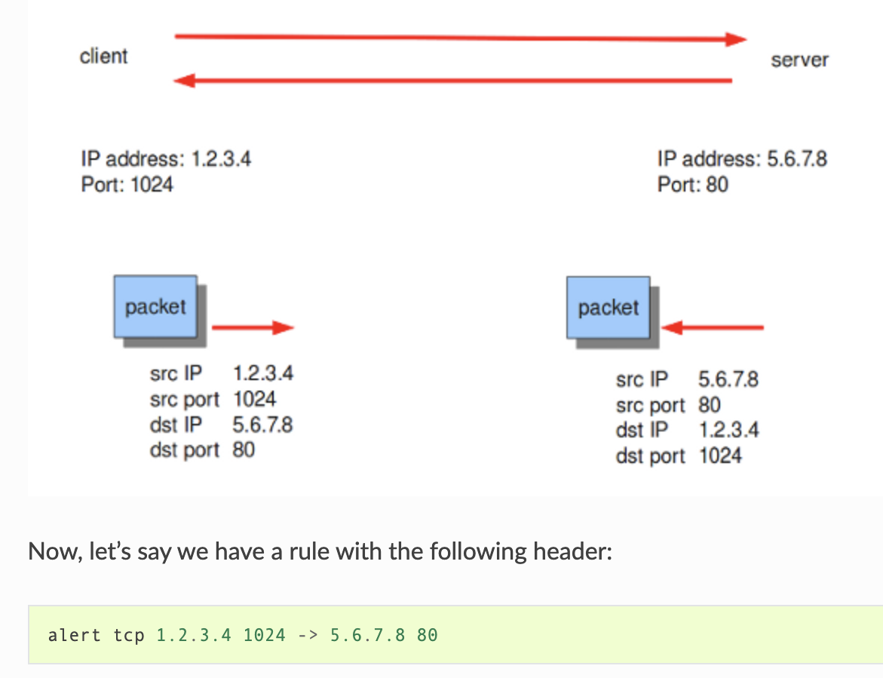
Cont’d…
Say, there is a client with IP address 1.2.3.4 and port 1024, and a server with IP address 5.6.7.8, listening on port 80 (typically HTTP). The client sends a message to the server, and the server replies with its answer.
Only the first packet will be matched by this rule, as the direction specifies that we do not match on the response packet.
https://docs.suricata.io/en/suricata-6.0.0/rules/intro.html

Slide 18
Drawbacks of Signature based IDS
They are unable to detect novel attacks.
Suffer from false alarms
Have to programmed again for every new pattern to be detected.

Slide 19
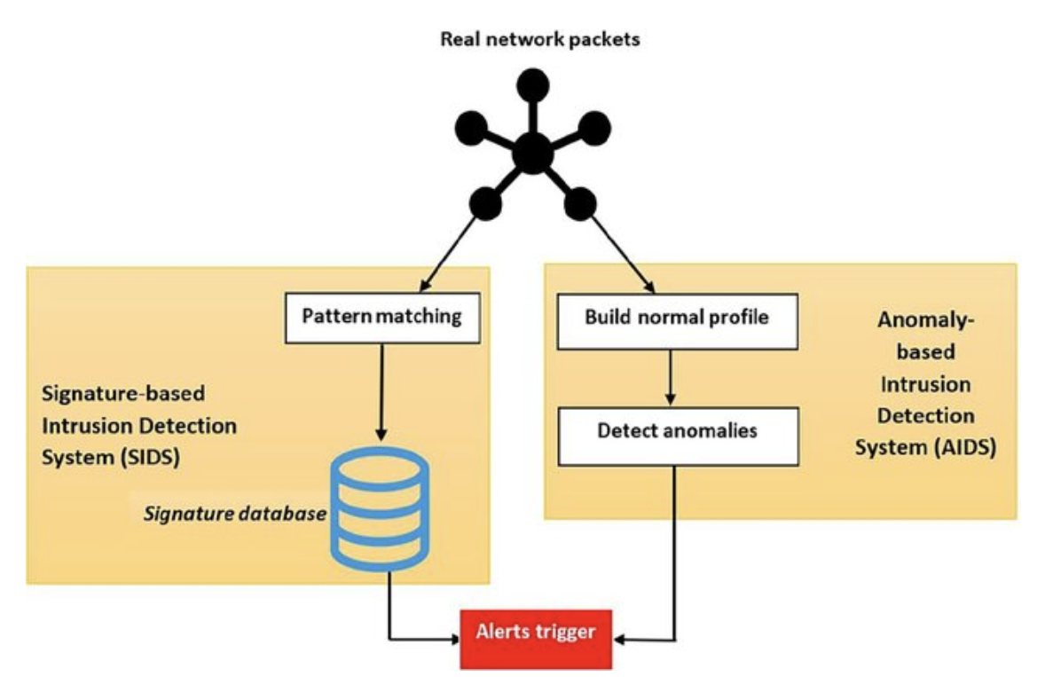
Anomaly based IDS
Deviation
Anomaly-based IDS typically works by taking a baseline of the normal traffic and activity taking place on the network.
It measures the present state of traffic on the network against this baseline in order to detect patterns that are not present in the traffic normally..
Notes:
Admin: who logins as root and assigns privileges to software developers
Software developer:responsible for coding, compiling, debugging, etc.
One day, the software developer goes to admin rothe admin room and finds out he is not there; hisis logged on as root. The developer changes his prevelages. Later, when he is doing some extra operation, it generates an alarm.

Slide 20
Types of IDS

Slide 21
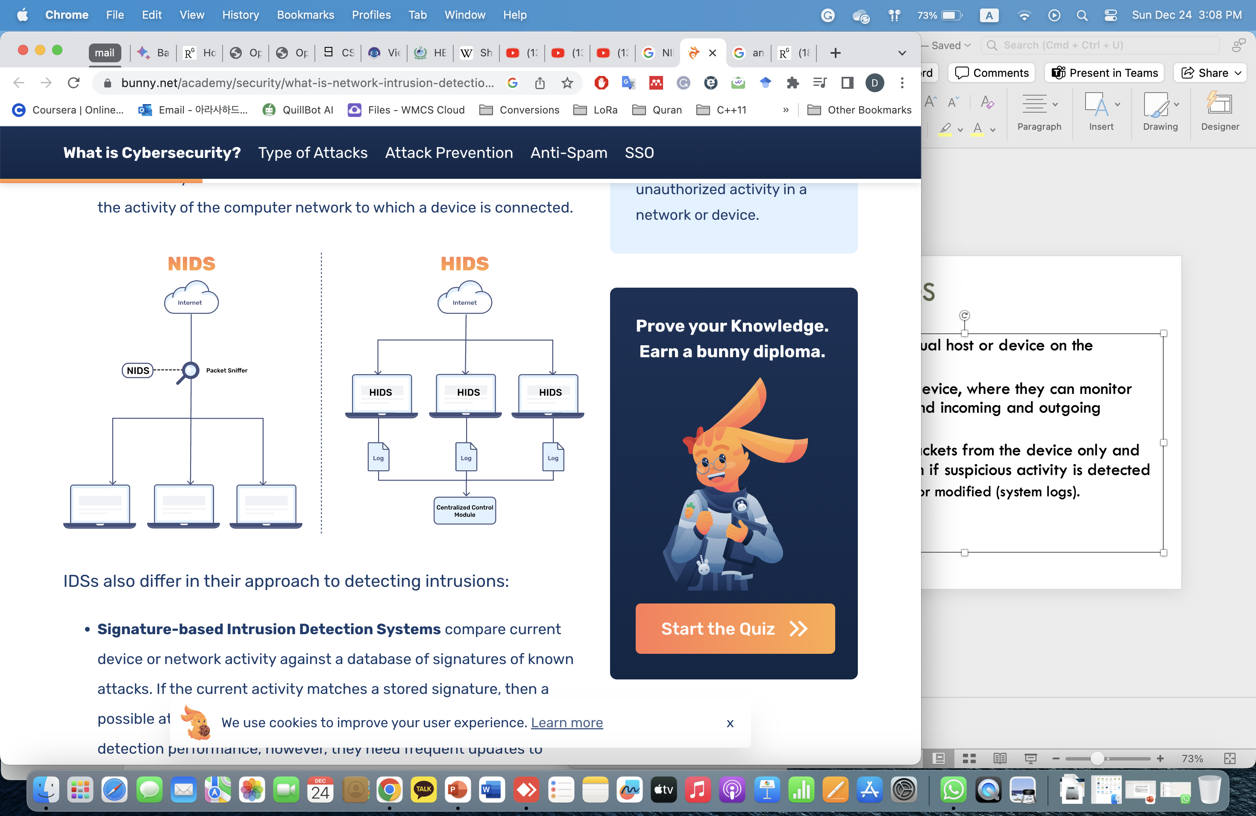
Host based IDS
Installed on individual host or device on the network.
Monitors a single device, where they can monitor the local activity and incoming and outgoing network traffic.
It monitors data packets from the device only and will alert the admin if suspicious activity is detected
E.g., files deleted or modified (system logs).

Slide 22
Strengths of the host based IDS
Attack verification
System specific activity
Near Real-Time detection and response.
No additional hardware

Slide 23
Network based IDS
Implemented on Network
Analysis: matches traffic to the library of known attacks
Monitors, captures and analyzes the network traffic.
Detects malicious data present in data packets.
A filter is usually applied to determine which traffic will be discarded or passed to an attack recognition module.
This helps to filter out known un-malicious traffic.

Slide 24
Strengths of Network based IDS
Packet analysis
Real time detection and response
Operating system independence

Slide 25
Commercial ID Systems
ISS – Real Secure from Internet Security Systems:
Real time IDS.
Contains both host and network based IDS.
Tripwire – File integrity assessment tool.
Bro and Snort – open source public-domain system.

Slide 26
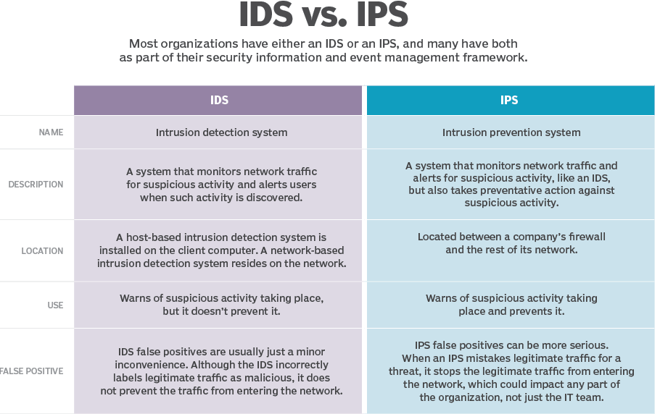

Slide 27
Thanks!

